Slide 1
Model Compression and Pruning
Team : Geetika Khanna, ARCHIT HARSH & HIMAL SHARMA
Github Repo

Slide 2
Introduction
Modern deep learning models (such as large neural networks) often have millions—even billions—of parameters. While these large models can achieve state-of-the-art performance, they also come with significant computational and storage costs. This high resource demand poses challenges for real-time inference, deployment on edge devices, and overall energy efficiency.
Model compression and pruning techniques aim to reduce the size of these large neural networks without significantly sacrificing accuracy. By selectively removing (or “pruning”) weights or neurons, create a smaller, faster, and more energy-efficient equivalent without significantly sacrificing predictive accuracy.
This project focuses on unstructured weight pruning, where individual weights can be removed regardless of their position.

Slide 3
Motivation
Edge AI: Enabling complex models to run directly on devices with limited power and computational budgets (e.g., smartphones, smart sensors).
Real-Time Performance: Reducing inference latency for applications demanding quick responses (e.g., autonomous navigation, interactive services).
Sustainability: Lowering the energy footprint associated with training and deploying large-scale AI models.
Cost Reduction: Decreasing hardware requirements (memory, storage) and operational expenses for cloud-based deployments.
Understanding Redundancy: Gaining insights into the inherent over-parameterization and redundancy often present within deep learning models.
This project aims to apply optimization concepts to systematically reduce model complexity, specifically targeting parameter count and computational load (measured via FLOPs), while explicitly controlling the impact on predictive accuracy.

Slide 4
Objective
The core problem is to
select an optimal subset of weights to keep (z_{j} = 1) or remove (z_{j} = 0)
from a pre-trained network W = {w₁,...,w_{N} }
to minimize model complexity while ensuring performance doesn’t degrade unacceptably.
Let z = {z₁,...,z_{N} } be the binary mask variables associated with each weight w_{j}, where W⊙z denotes the element-wise multiplication representing the pruned network.

Slide 5
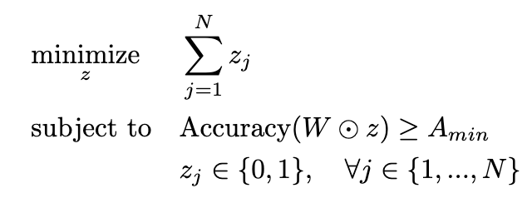
Mathematical Optimization Formulation 1
Formulation 1: Constrained Optimization (Minimize Size subject to Accuracy)
This formulation directly reflects the common practical goal: find the smallest possible model (fewest active parameters) that still meets a minimum performance standard.
Where,
The objective is explicitly to minimize the number of kept parameters (∑z_{j} )
A_{min} is the minimum acceptable accuracy threshold.
This formulation clearly states the objective but involves a complex, non-linear constraint related to accuracy.

Slide 6
Numerical Solver - iGreedy
Method 1: Iterative Greedy Magnitude Pruning with Fine-tuning (iGreedy Threshold)
This method directly attempts to solve the constrained optimization problem (Formulation 1) heuristically. It iteratively increases sparsity (minimizing ∑z_{j} ) by greedily removing the smallest magnitude weights and stops when the accuracy constraint (Accuracy ≥ Amin) is about to be violated.
Algorithm:
Start with a trained dense model.
Define A_{min} and a pruning step amount p.
Loop:
Calculate target global sparsity to remove p% of remaining weights.
Prune globally using L1 magnitude.
Fine-tune.
Evaluate accuracy A_{current}.
If A_{current} ≥A_{min}, save model and continue.
If A_{current} < A_{min}, stop; the last saved model is the result.
Pros:
Direct control over minimum accuracy, intuitive.
Cons
Greedy, not guaranteed optimal, result depends on step size p.

Slide 7
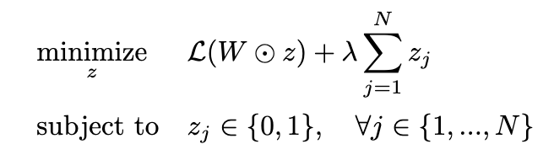
Mathematical Optimization Formulation 2
Formulation 2: Penalized Objective (Minimize Loss + Sparsity Penalty)
This formulation combines the task performance (loss) and model complexity (number of parameters) into a single objective function using a trade-off parameter λ.
Where,
L(W ⊙z) is the loss function (e.g., cross-entropy) evaluated on a dataset using the pruned network. Minimizing this term promotes accuracy.
∑ z_{j} is the total number of non-zero (kept) parameters. Minimizing this term promotes sparsity.
λ ≥ 0 is a hyperparameter controlling the trade-off. A larger λ places more emphasis on reducing the number of parameters (increasing sparsity) relative to minimizing the loss.
This formulation directly balances the two competing goals within the objective function itself.

Slide 8
Numerical Solver – L1 Regularization
Method 2: L1 Regularization during Training with Thresholding
This method relates to the penalized objective (Formulation 2). The L1 penalty λ′∑|w_{j} | added during training encourages weights w_{j} to shrink, implicitly minimizing the count of significant weights, similar to penalizing ∑z_{j} . The hyperparameter λ′ in the code corresponds conceptually to λ in Formulation 2.
Algorithm:
Train using L1-regularized loss: L_{total}(W) = L_{CE} (W) + λ′∑|wj |.
Thresholding: After training, set weights |w_{j} |< ε to zero (ε is the threshold).
Fine-tuning: Fine-tune the thresholded network without the L1 penalty.
Pros:
Integrates sparsity into training optimization.
Cons
Requires tuning λ′and ε; final sparsity is an outcome, not directly controlled.
L1 regularization is a very common and practical heuristic or proxy method to encourage sparsity. The idea is that by penalizing the L1 norm of the weights, many weights will be driven towards zero. Those that are driven sufficiently close to zero can then be set to exactly zero by the subsequent thresholding step.

Slide 9
Challenge and Heuristics
Both formulations result in a Mixed Integer Non-Linear Program (MINLP) due to the binary variables z_{j} and the non-linear loss/accuracy functions.
Solving such MINLPs optimally for the vast number of parameters (N) in neural networks is computationally intractable.
Therefore, practical approaches rely on heuristic numerical methods that aim to find good, though not necessarily globally optimal, solutions relevant to these formulations.

Slide 10
Implementation Details
Dataset:
CIFAR-10 (32x32 color images, 10 classes), automatically downloaded and prepared using torchvision.datasets.CIFAR10 and standard transforms (normalization, random crops/flips for training) defined in src/data loader.py.
Model:
A SimpleCNN architecture implemented in src/model.py, consisting of four convolutional layers with ReLU activations and max-pooling, followed by dropout and two fully connected layers.
Framework: PyTorch
Device Handling: Automatic detection and utilization of the best available hardware accelerator (mps, cuda, or cpu) via src.utils.get device. Explicit .float() conversions and model.to(device) calls are strategically placed within training, fine-tuning, and evaluation loops to ensure data type (float32) and device consistency, addressing issues observed particularly with the MPS backend. Models are consistently saved to disk from their CPU state representation.
Metrics:
Accuracy: Standard top-1 classification accuracy on the test set.
Sparsity: Percentage of weight parameters (in Conv2d and Linear layers) exactly equal to zero.
Parameter Count: Total number of trainable parameters and number of non-zero trainable parameters.
FLOPs (Floating Point Operations): Estimated using the thop library. This metric provides a proxy for the computational cost of a forward pass. Note that for unstructured pruning, the theoretical FLOP count based on architecture often doesn’t decrease significantly, but it serves as a baseline and highlights the potential for speedup if specialized hardware/kernels were used.

Slide 11
Results
Type | Name | Accuracy (%) | Sparsity (%) | Non-Zero Params | GFLOPs
Base | base_model.pth | 85.49 | 0.00 | 4440778 | 0.16
L1Reg | final_l1_pruned_model_1e-5.pth | 87.28 | 58.33 | 1850772 | 0.16
L1Reg | final_l1_pruned_model_1e-4.pth | 85.39 | 68.27 | 1409645 | 0.16
iGreedy | pruned_model_iter_0_sparsity_0.0.pth | 85.49 | 0.00 | 4440778 | 0.16
iGreedy | pruned_model_iter_1_sparsity_20.0.pth | 85.37 | 16.14 | 3724057 | 0.16
iGreedy | pruned_model_iter_2_sparsity_36.0.pth | 85.49 | 27.05 | 3239634 | 0.16
iGreedy | pruned_model_iter_3_sparsity_48.8.pth | 85.75 | 28.28 | 3185379 | 0.16
iGreedy | pruned_model_iter_4_sparsity_59.0.pth | 85.79 | 35.53 | 2863200 | 0.16
iGreedy | pruned_model_iter_6_sparsity_64.5.pth | 85.74 | 33.68 | 2945309 | 0.16
iGreedy | pruned_model_iter_5_sparsity_67.2.pth | 85.66 | 33.90 | 2935507 | 0.16
iGreedy | pruned_model_iter_7_sparsity_71.6.pth | 85.84 | 30.74 | 3075815 | 0.16
iGreedy | pruned_model_iter_8_sparsity_77.3.pth | 85.35 | 29.45 | 3133297 | 0.16
iGreedy | pruned_model_iter_9_sparsity_81.8.pth | 84.88 | 29.20 | 3144454 | 0.16

Slide 12
Numerical Results & Analysis
iGreedy Threshold Pruning:
The script iteratively pruned 20% of remaining weights and fine-tuned for 5 epochs per iteration.
It stopped after 10 iterations, identifying the model from this iteration as the last one meeting the threshold of 84% accuracy.
The model was able to achieve 84.88% accuracy compared to 85.49% accuracy of base model with a sparsity of 29.2%.
It achieved maximum sparsity of 35.33% while maintaining an accuracy of 85.79% compared to 85.49% accuracy of base model.
L1 Regularization Pruning:
The script ran with twice ->
l1_lambda as ‘1e-5’ and threshold ‘1e-4’
l1_lambda as ‘1e-4’ and threshold ‘1e-3’
It tool the base model as a starting point and trained it for 50 epochs followed by fine tuning of 10 Epochs.
The “l1_lambda as ‘1e-4’ and threshold ‘1e-3’” was able to achieve 85.39% accuracy compared to 85.49% accuracy of base model with a sparsity of 68.27%.
The “l1_lambda as ‘1e-5’ and threshold ‘1e-4’” was able to achieve 87.28% accuracy compared to 85.49% accuracy of base model with a sparsity of 58.33%.

Slide 13
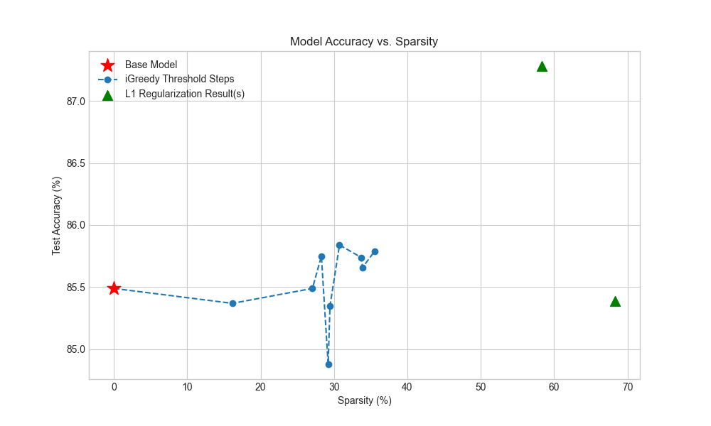
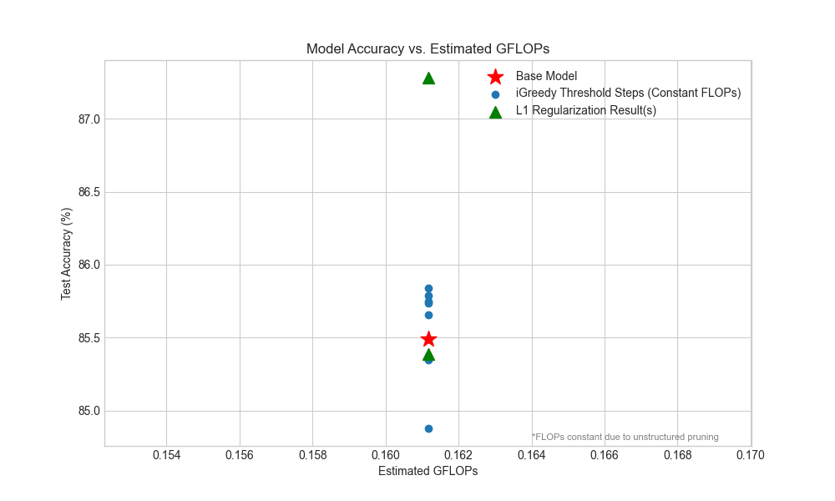
Comparison Plot

Slide 14
Conclusion
Heuristic methods like iterative pruning and L1 regularization provide practical ways to approximate solutions to the complex underlying optimization problem.
Accuracy:
Both heuristic methods successfully compressed the model while maintaining accuracy above the 84% target.
iGreedy
Achieved comparable accuracy while keeping sparsity (~30%-35%).
Provided explicit control over the minimum acceptable accuracy.
L1 Regularization
Achieved greater sparsity (~60% and above) while maintaining comparable accuracy
With appropriate hyperparameter tuning, achieved slightly better compression for similar accuracy.
The constant FLOPs highlight that the primary benefits of this type of pruning are reduced model complaexity (storage, memory bandwidth) rather than direct computational speedup on standard hardware without specialized kernels.
This project successfully investigated the optimization challenge of neural network pruning. By formulating the problem mathematically (using both constrained and penalized objectives) and implementing two distinct heuristic numerical solvers—iterative greedy magnitude pruning constrained by an accuracy threshold (iGreedy) and L1 regularization with thresholding—we demonstrated effective techniques for compressing a CNN on the CIFAR-10 dataset.

